Slide 1
Security

Slide 2
Security Threats, Policies, and Mechanisms
Types of security threats to consider:
Interception
Interruption
Modification
Fabrication

Slide 3
Security policy
Security mechanism

Slide 4
Security mechanism
Encryption
Authentication
Authorization
Auditing

Slide 5
Example: The Globus Security Architecture (1)
The environment consists of multiple administrative domains.
Local operations are subject to a local domain security policy only.
Global operations require the initiator to be known in each domain where the operation is carried out.

Slide 6
Example: The Globus Security Architecture (2)
Operations between entities in different domains require mutual authentication.
Global authentication replaces local authentication.
Controlling access to resources is subject to local security only.
Users can delegate rights to processes.
A group of processes in the same domain can share credentials.

Slide 7
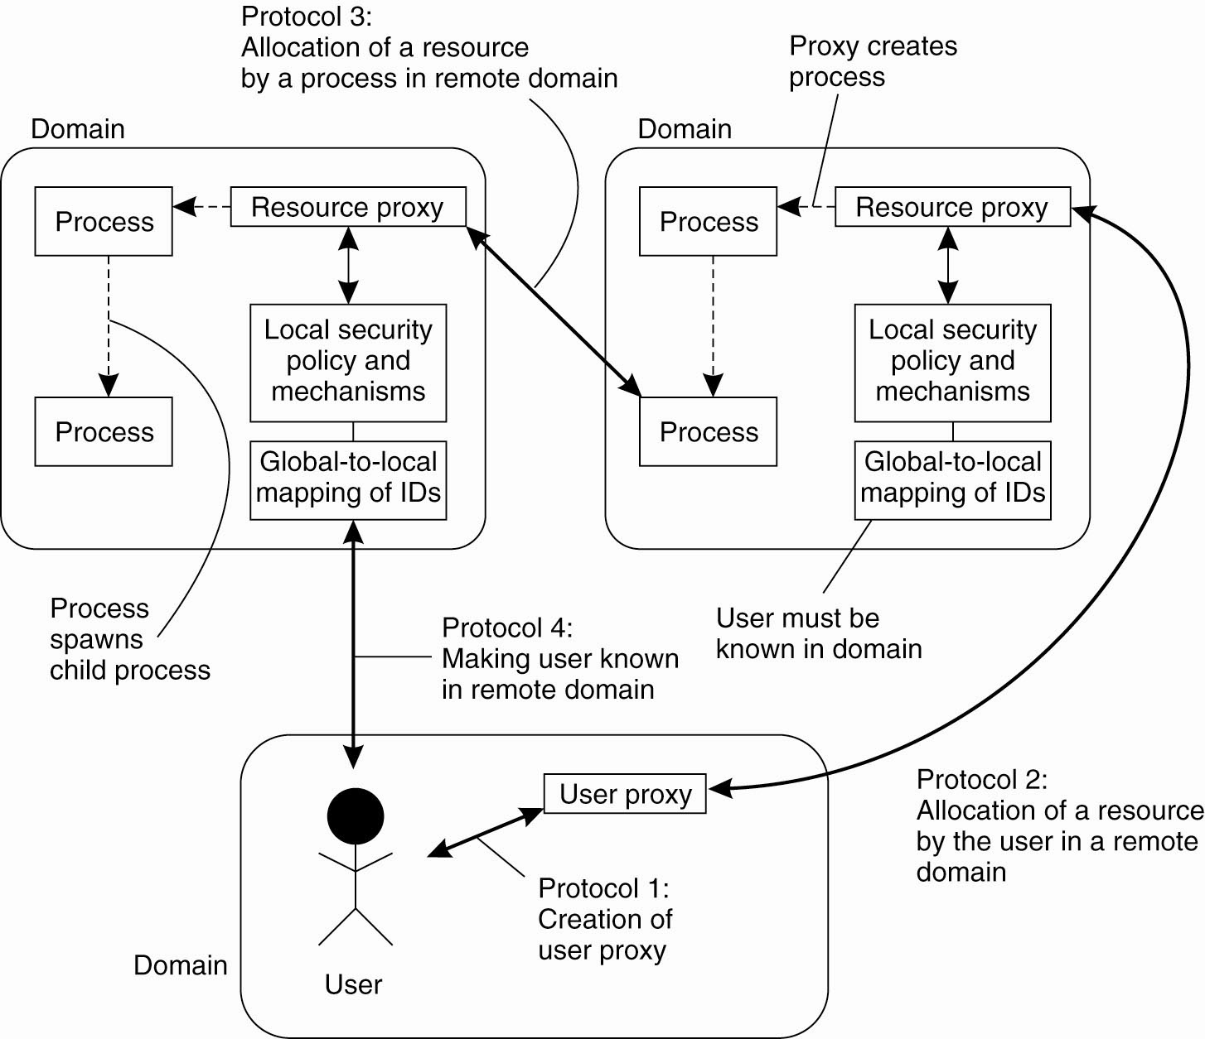
Example: The Globus
Security Architecture (2)
Figure 9-1. The Globus security architecture.

Slide 8
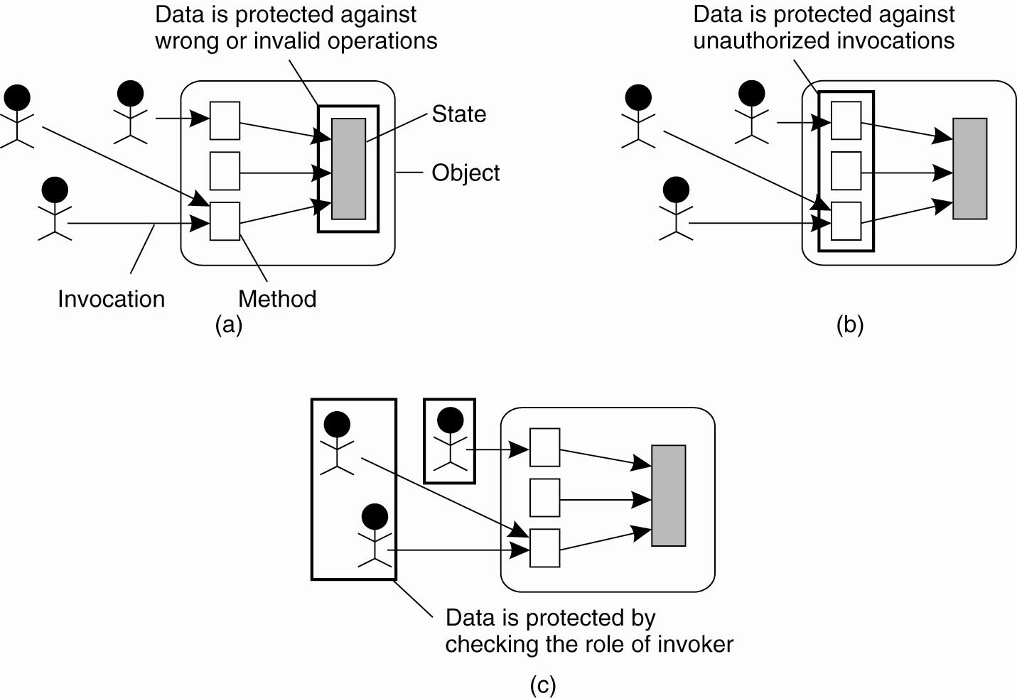
Focus of Control (1)
Figure 9-2. Three approaches for protection against security threats. (a) Protection against invalid operations

Slide 9
Focus of Control (2)
Figure 9-2. Three approaches for protection against security threats. (b) Protection against unauthorized invocations.

Slide 10
Focus of Control (3)
Figure 9-2. Three approaches for protection against security threats. (c) Protection against unauthorized users.

Slide 11
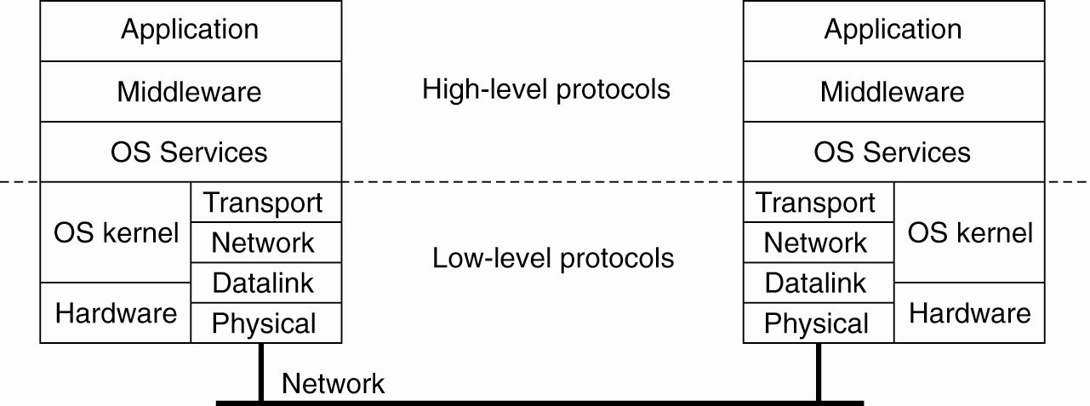
Layering of Security Mechanisms (1)
Figure 9-3. The logical organization of a
distributed system into several layers.

Slide 12
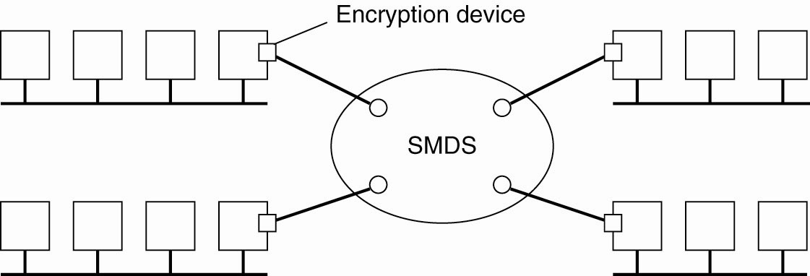
Layering of Security Mechanisms (2)
Figure 9-4. Several sites connected through
a wide-area backbone service.

Slide 13
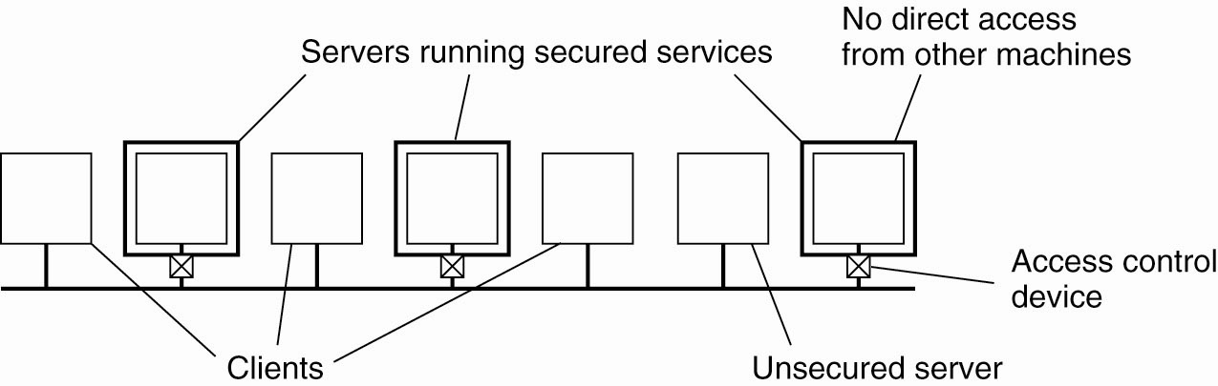
Distribution of Security Mechanisms
Figure 9-5. The principle of RISSC as
applied to secure distributed systems.

Slide 14
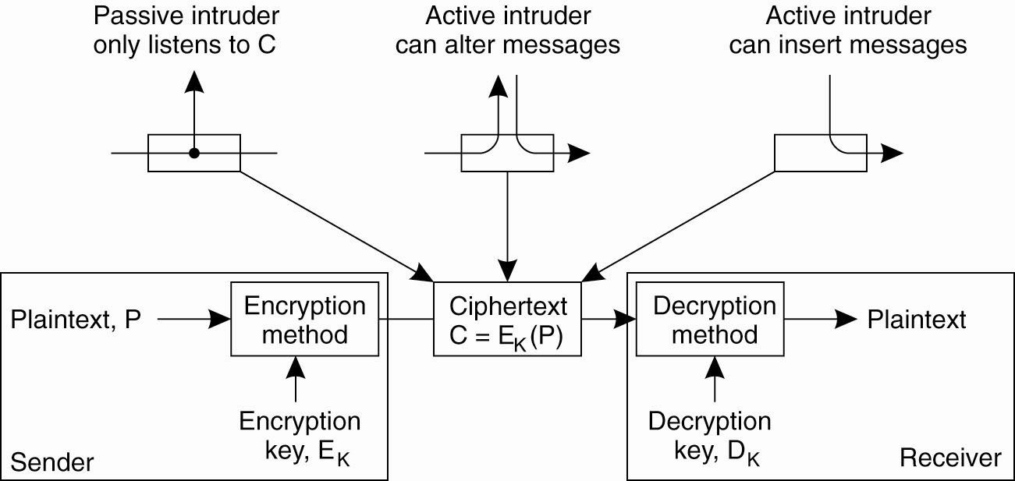
Cryptography (1)
Figure 9-6. Intruders and eavesdroppers in communication.

Slide 15
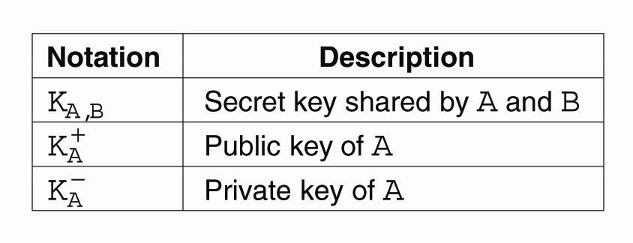
Cryptography (2)
Figure 9-7. Notation used in this chapter.

Slide 16
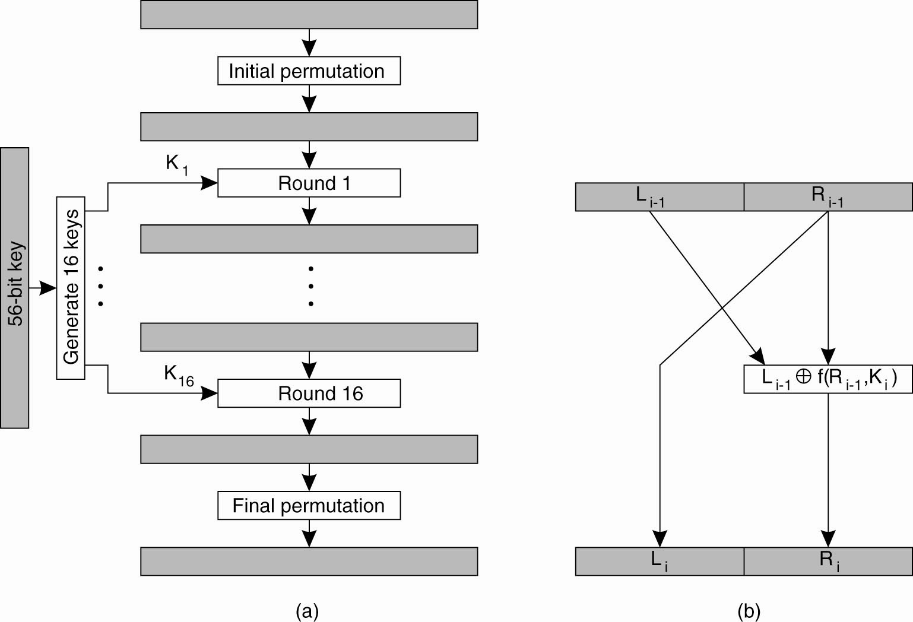
Symmetric Cryptosystems: DES (1)
Figure 9-8. (a) The principle of DES.

Slide 17
Symmetric Cryptosystems: DES (2)
Figure 9-8. (b) Outline of
one encryption round.

Slide 18
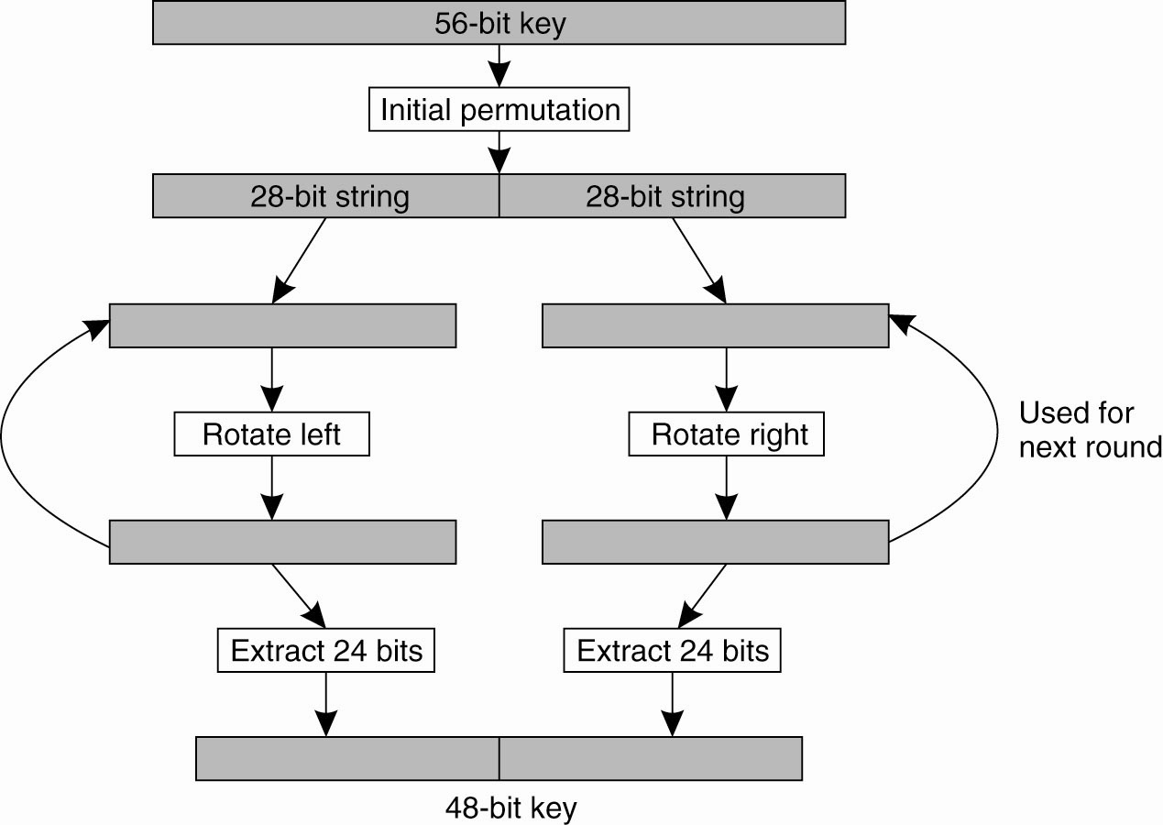
Symmetric Cryptosystems: DES (3)
Figure 9-9. Details of per-round key generation in DES.

Slide 19
Public-Key Cryptosystems: RSA
Generating the private and public keys requires
four steps:
Choose two very large prime numbers, p and q.
Compute n = p × q and z = (p − 1) × (q − 1).
Choose a number d that is relatively prime to z.
Compute the number e such that
e × d = 1 mod z.

Slide 20
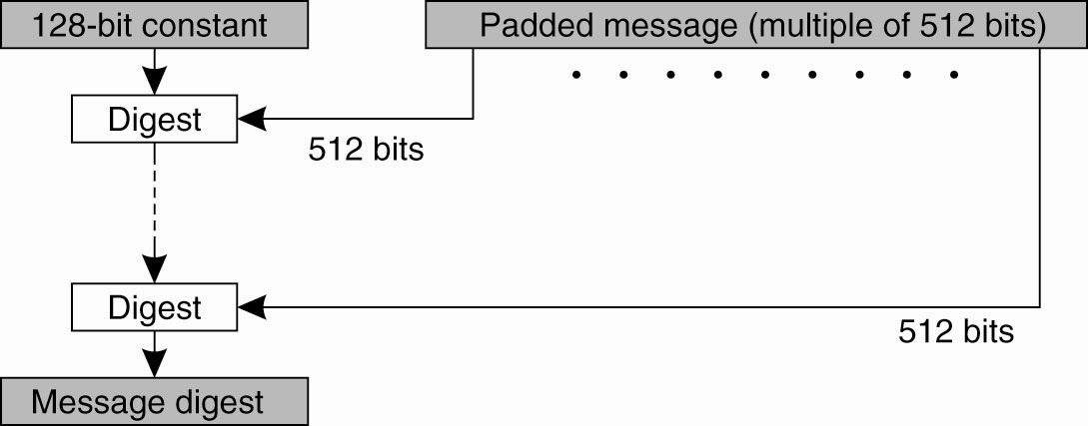
Hash Functions: MD5 (1)
Figure 9-10. The structure of MD5.

Slide 21
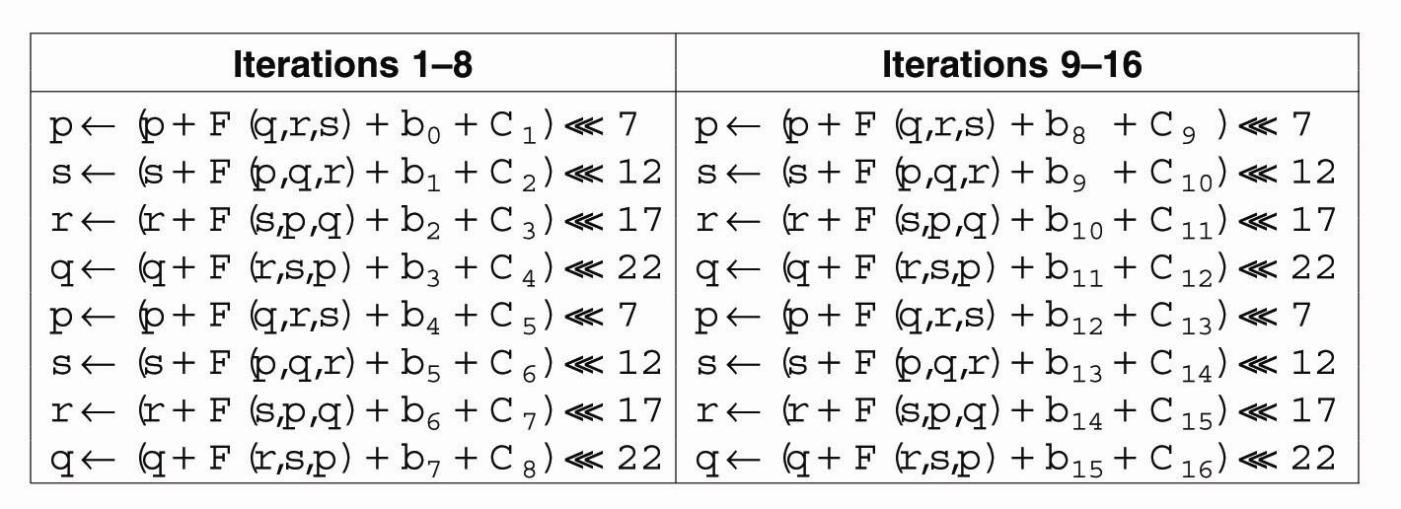
Hash Functions: MD5 (2)
Figure 9-11. The 16 iterations during the
first round in a phase in MD5.

Slide 22
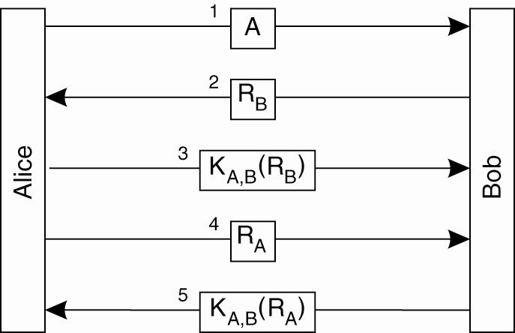
Authentication Based on a Shared Secret Key (1)
Figure 9-12. Authentication based on a shared secret key.

Slide 23
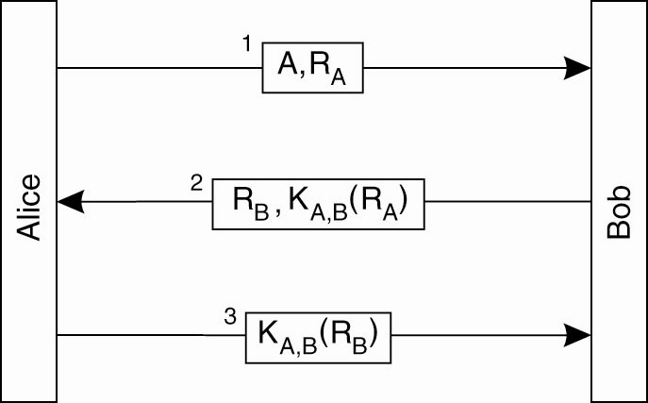
Authentication Based on a Shared Secret Key (2)
Figure 9-13. Authentication based on a shared secret key, but using three instead of five messages.

Slide 24
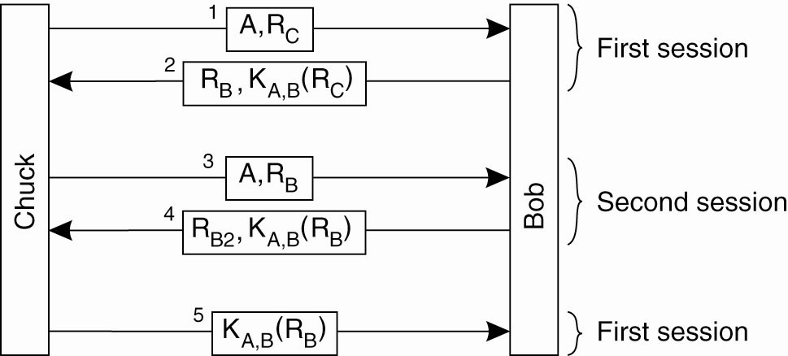
Authentication Based on a Shared Secret Key (3)
Figure 9-14. The reflection attack.

Slide 25
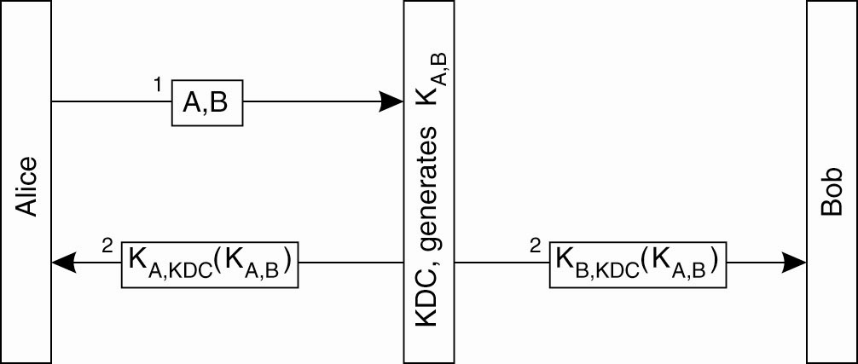
Authentication Using a
Key Distribution Center (1)
Figure 9-15. The principle of using a KDC.

Slide 26
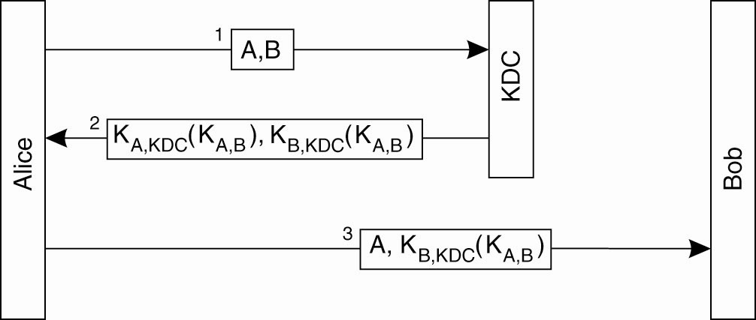
Authentication Using a
Key Distribution Center (2)
Figure 9-16. Using a ticket and letting
Alice set up a connection to Bob.

Slide 27
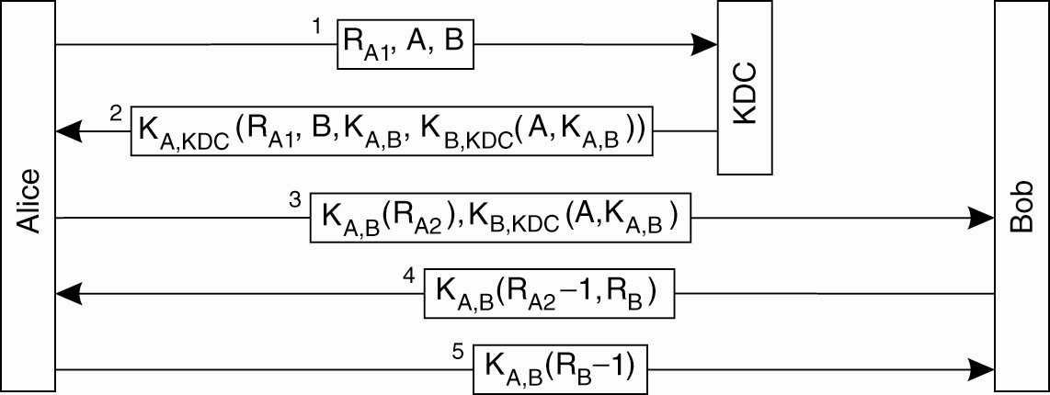
Authentication Using a
Key Distribution Center (3)
Figure 9-17. The Needham-Schroeder authentication protocol.

Slide 28
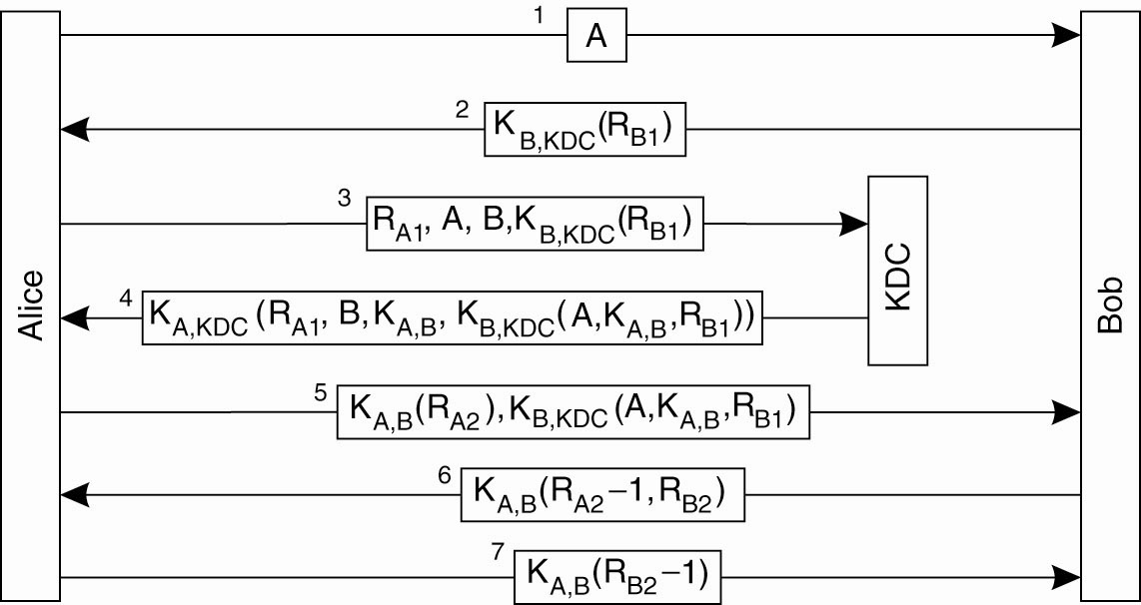
Authentication Using a
Key Distribution Center (4)
Figure 9-18. Protection against malicious reuse of a previously generated session key in the Needham-Schroeder protocol.

Slide 29
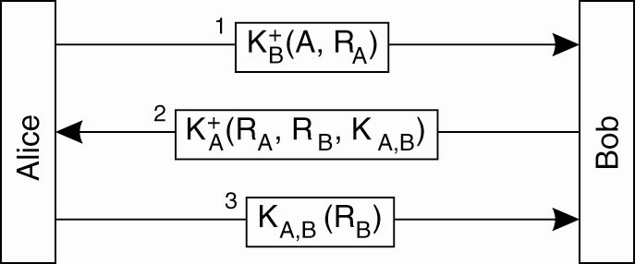
Authentication Using a
Key Distribution Center (5)
Figure 9-19. Mutual authentication in a public-key cryptosystem.

Slide 30
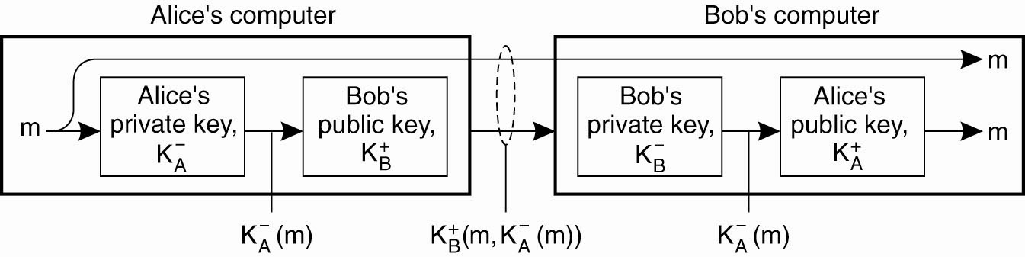
Digital Signatures (1)
Figure 9-20. Digital signing a message
using public-key cryptography.

Slide 31
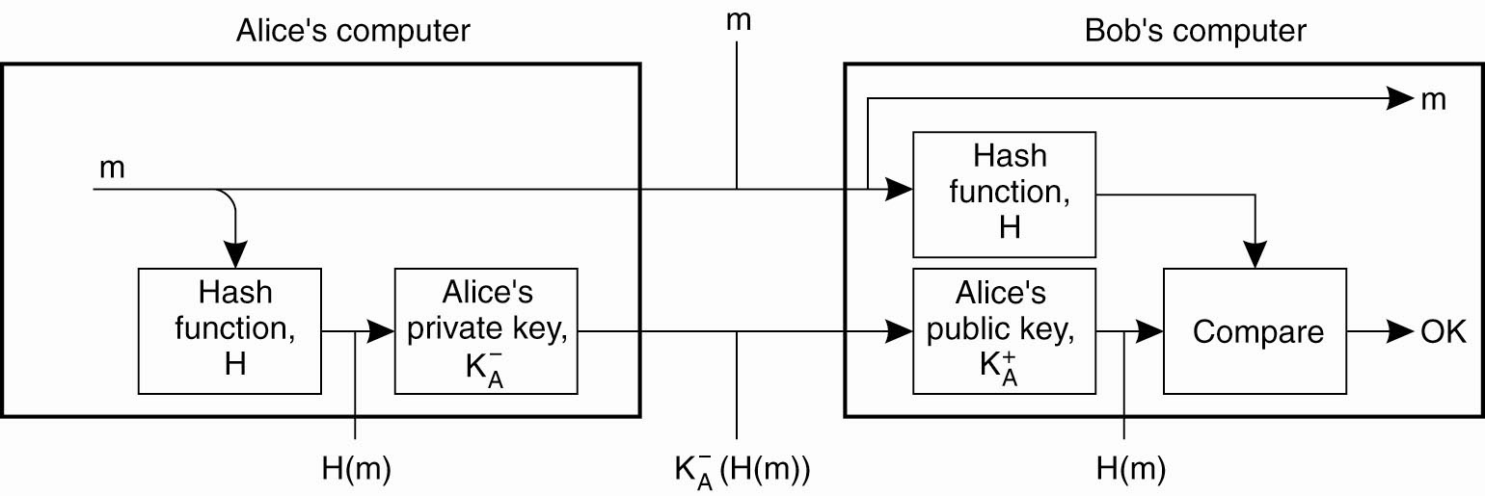
Digital Signatures (2)
Figure 9-21. Digitally signing a message using a message digest.

Slide 32
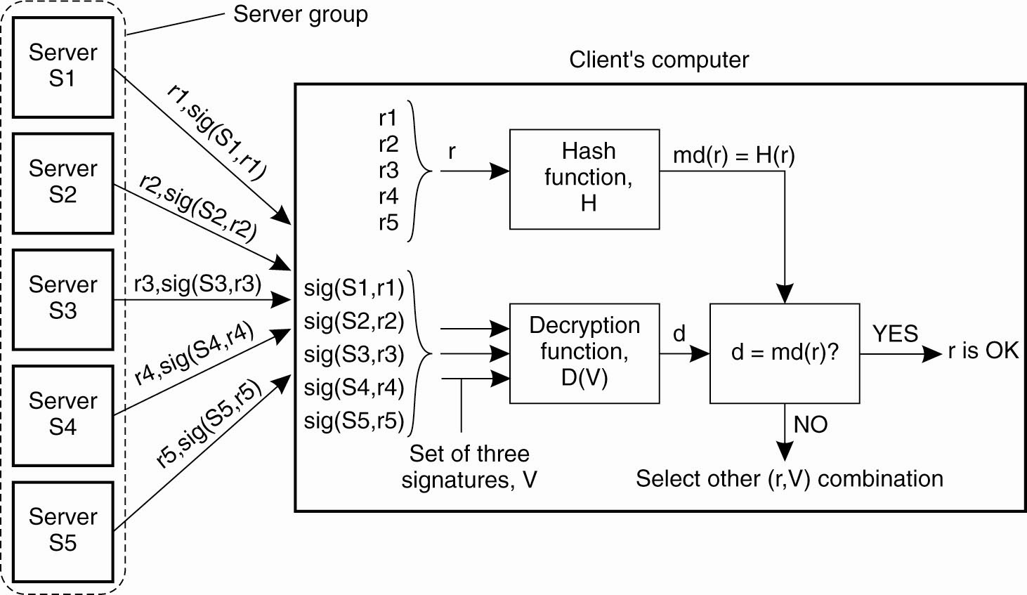
Secure Replicated Servers
Figure 9-22. Sharing a secret signature
in a group of replicated servers.

Slide 33
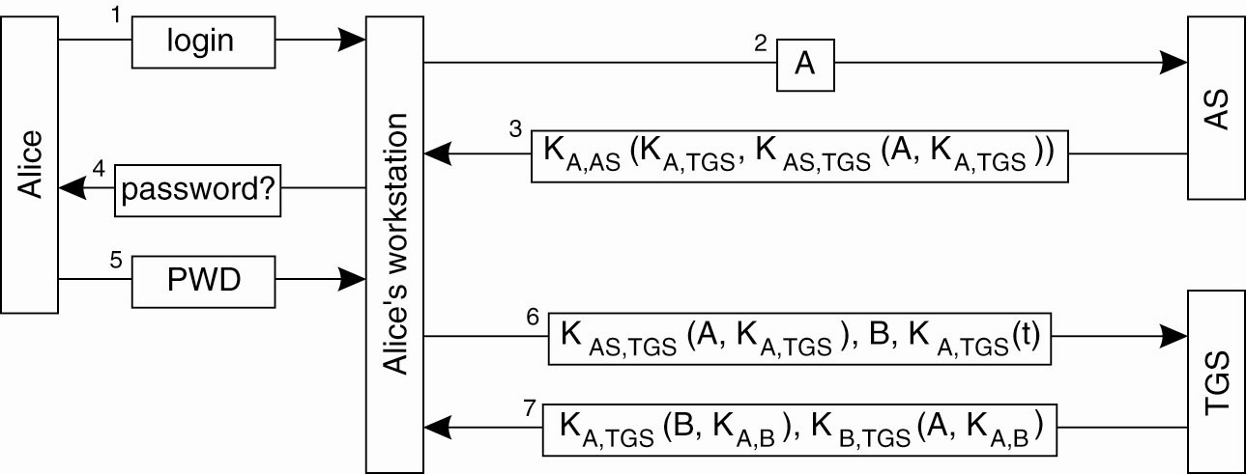
Example: Kerberos (1)
Figure 9-23. Authentication in Kerberos.

Slide 34
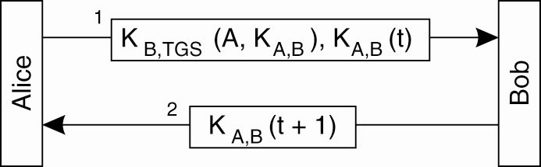
Example: Kerberos (2)
Figure 9-24. Setting up a secure channel in Kerberos.

Slide 35
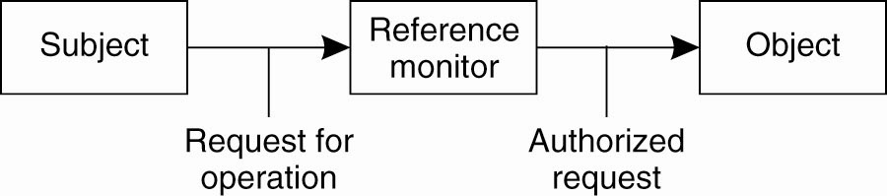
General Issues in Access Control
Figure 9-25. General model of controlling access to objects.

Slide 36
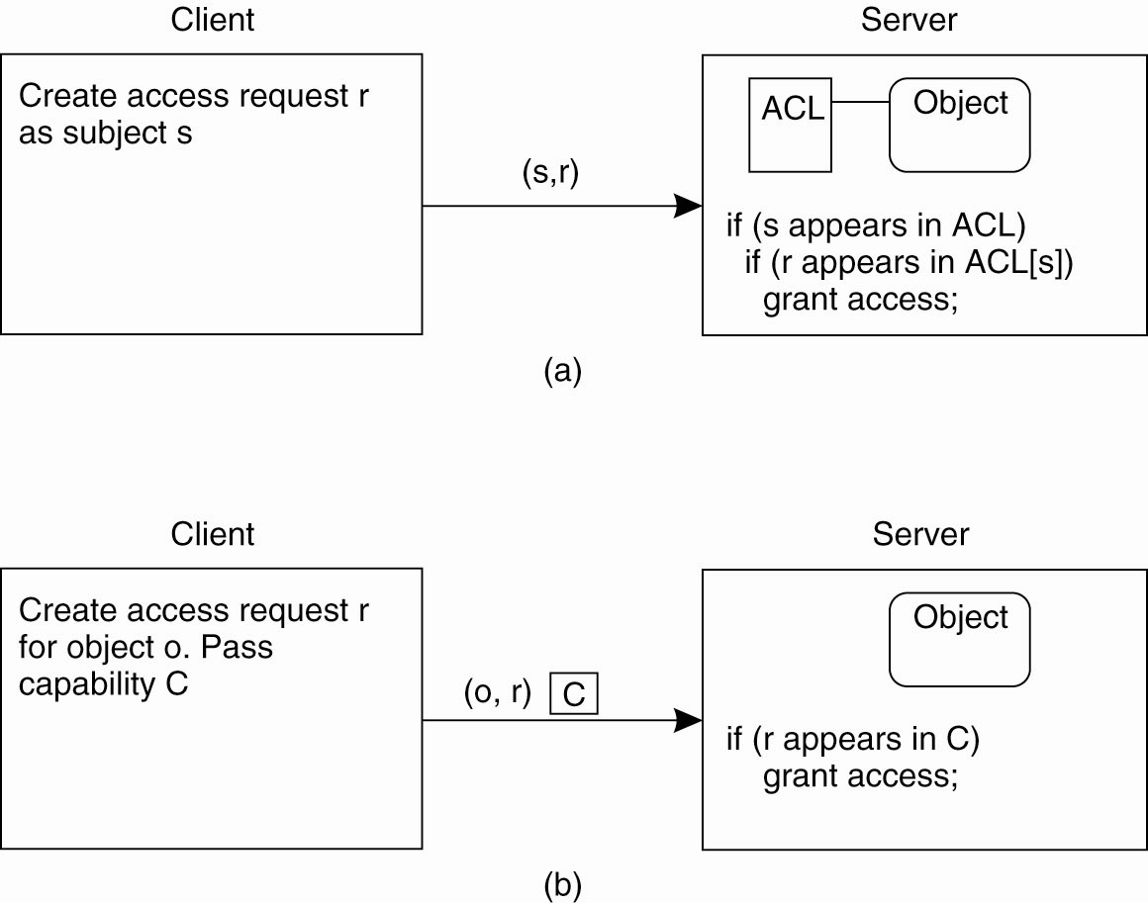
Access Control Matrix (1)
Figure 9-26. Comparison between ACLs and capabilities for protecting objects. (a) Using an ACL.

Slide 37
Access Control Matrix (2)
Figure 9-26. Comparison between ACLs and capabilities for protecting objects. (b) Using capabilities.

Slide 38
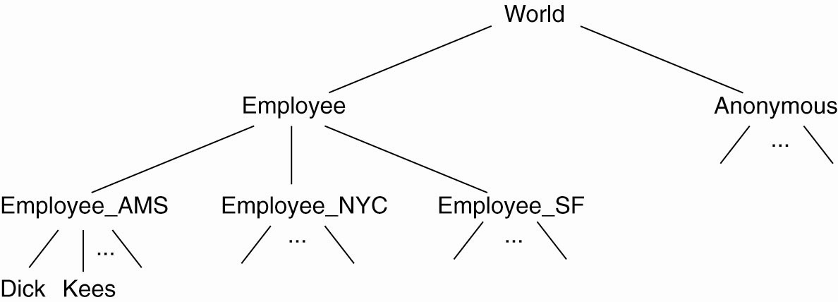
Protection Domains
Figure 9-27. The hierarchical organization of
protection domains as groups of users.

Slide 39
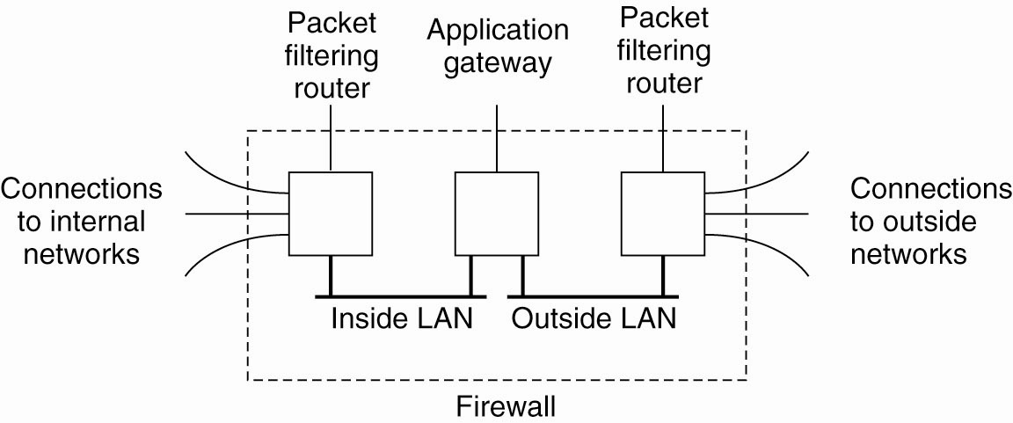
Firewalls
Figure 9-28. A common implementation of a firewall.

Slide 40
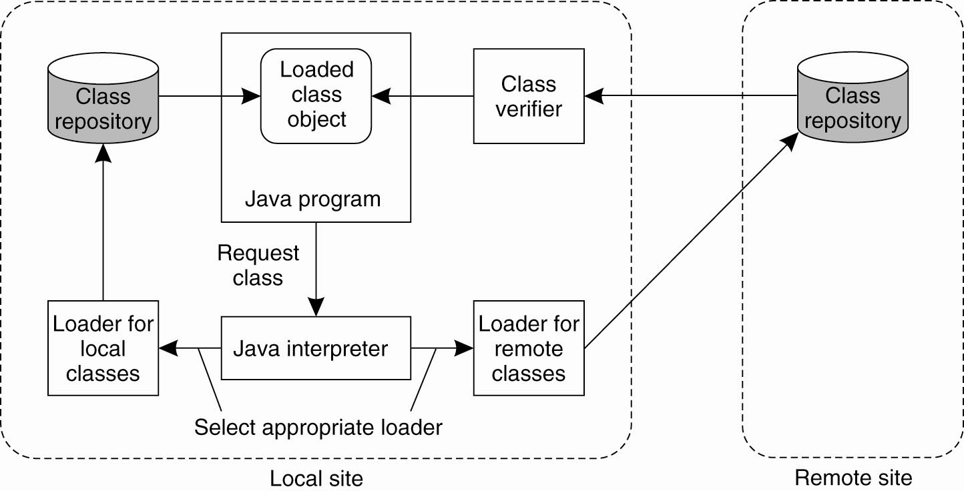
Protecting the Target (1)
Figure 9-29. The organization of a Java sandbox.

Slide 41
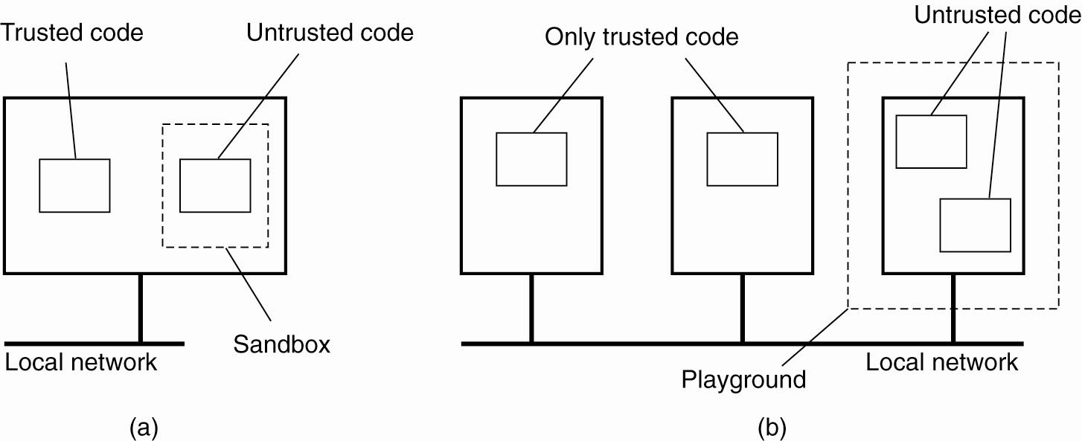
Protecting the Target (2)
Figure 9-30. (a) A sandbox. (b) A playground.

Slide 42
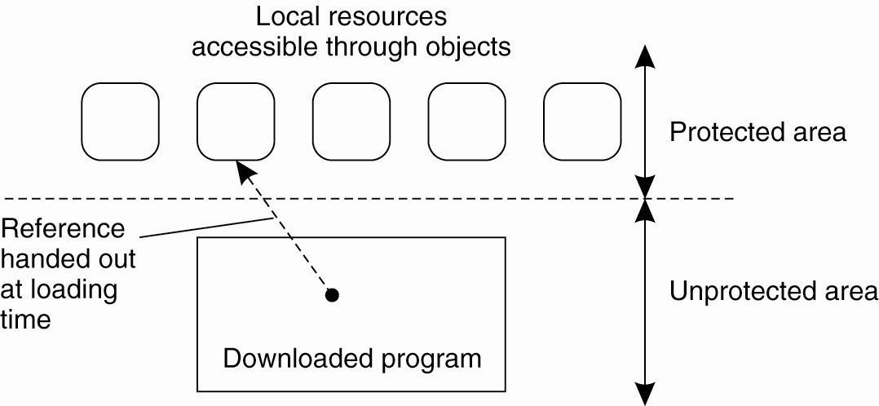
Protecting the Target (3)
Figure 9-31. The principle of using Java object references as capabilities.

Slide 43
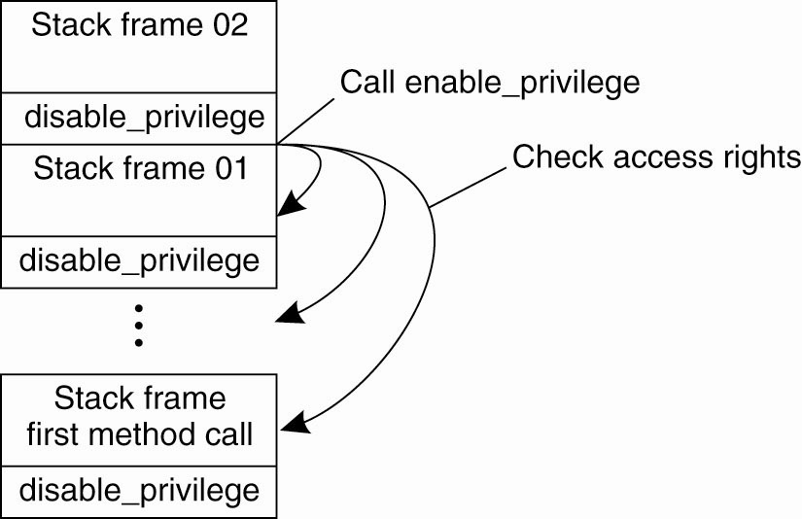
Protecting the Target (4)
Figure 9-32. The principle of stack introspection.

Slide 44
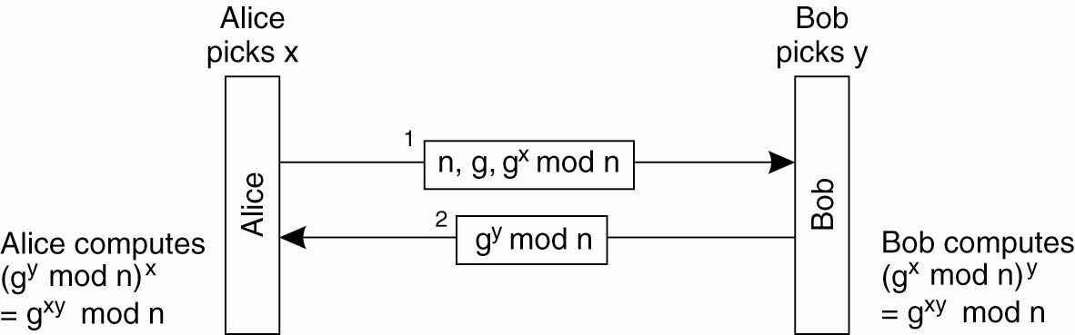
Key Establishment
Figure 9-33. The principle of Diffie-Hellman key exchange.

Slide 45
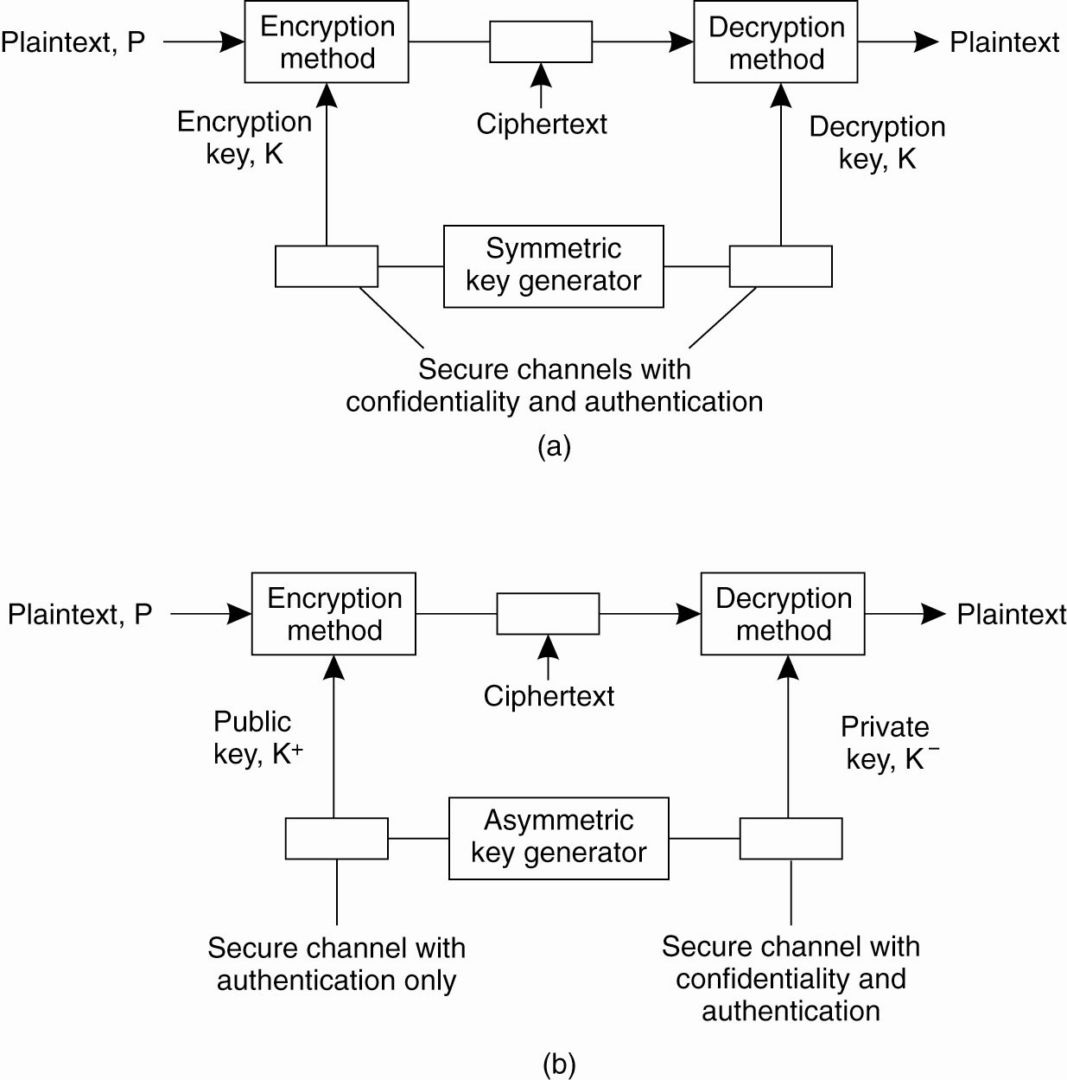
Key Distribution (1)
Figure 9-34. (a) Secret-key distribution.
[see also Menezes et al. (1996)].

Slide 46
Key Distribution (2)
Figure 9-34. (b) Public-key distribution
[see also Menezes et al. (1996)].

Slide 47
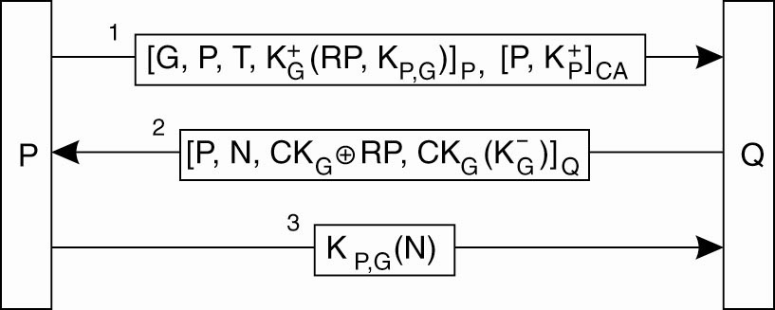
Secure Group Management
Figure 9-35. Securely admitting a new group member.

Slide 48
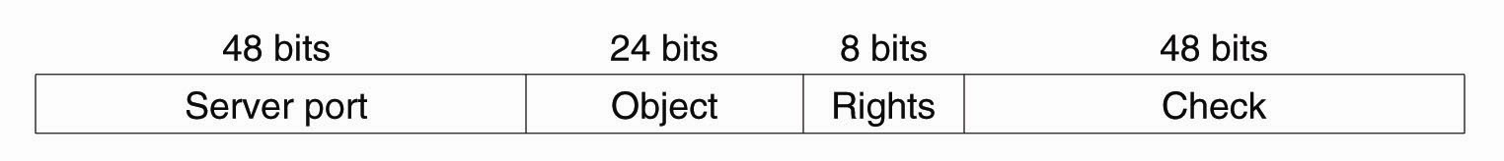
Capabilities and Attribute Certificates (1)
Figure 9-36. A capability in Amoeba.

Slide 49
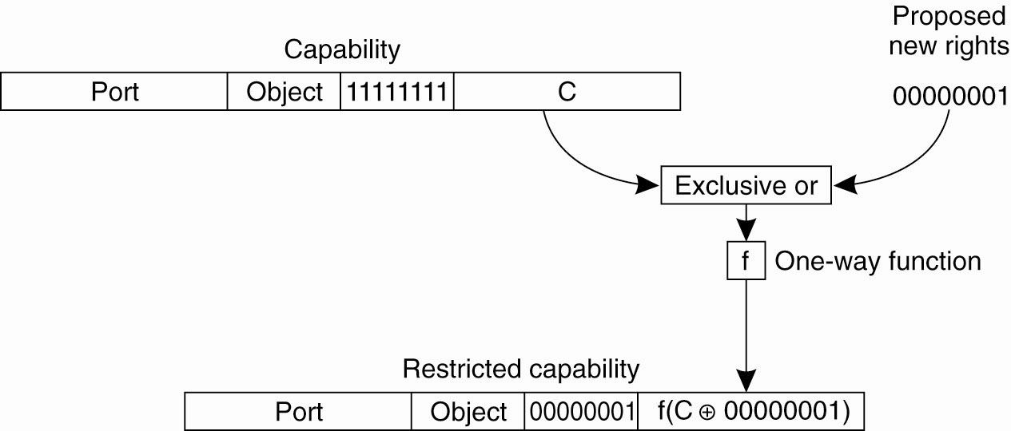
Capabilities and Attribute Certificates (2)
Figure 9-37. Generation of a restricted capability
from an owner capability.

Slide 50
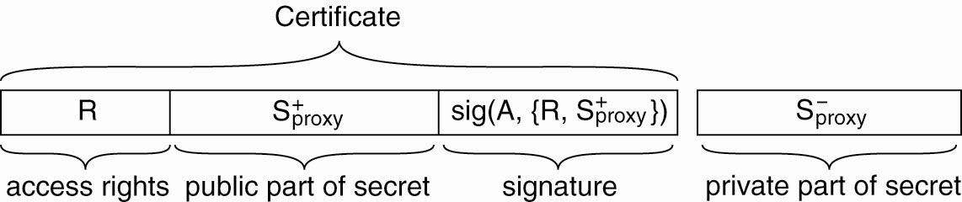
Delegation (1)
Figure 9-38. The general structure of a
proxy as used for delegation.

Slide 51
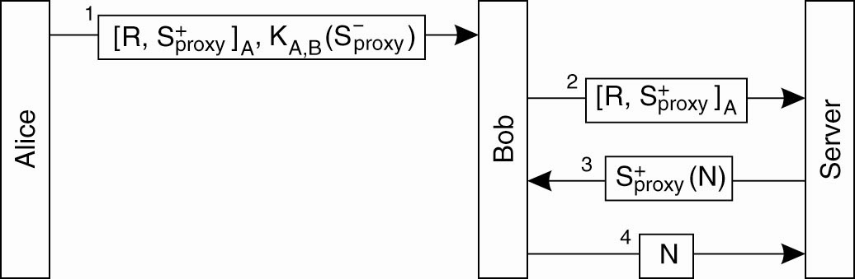
Delegation (2)
Figure 9-39. Using a proxy to delegate and
prove ownership of access rights.

